Slide 1
Error Handling
By Nasirdin

Slide 2
Recap – Module Operator (%)
6 % 2 === 0 → true (because 6 divided by 2 has a remainder of 0, so 6 is even).
7 % 2 === 0 → false (because 7 divided by 2 leaves a remainder of 1, so 7 is odd).
We deduct the two numbers:
6-2= 4, 4-2=2, 2-2= 0
7-2= 5, 5-2=3, 3-2= 1

Slide 3
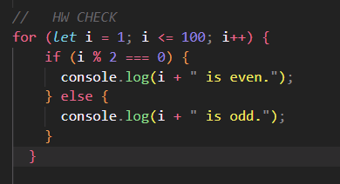
HW

Slide 4
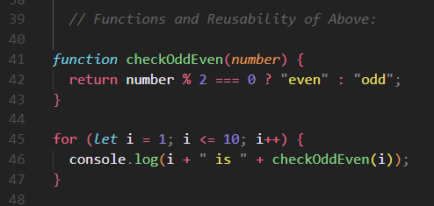
Functions and Reusability

Slide 5
User Input and Validation
Using prompt() to gather user input.
Validating input to ensure it’s a number.
Handling invalid input gracefully.
let userInput = prompt("Enter a number:");
isNaN - value is not a number
parseInt() - Convert String to INT

Slide 6
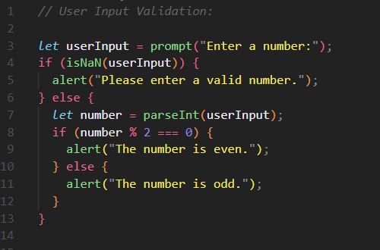
User Input

Slide 7
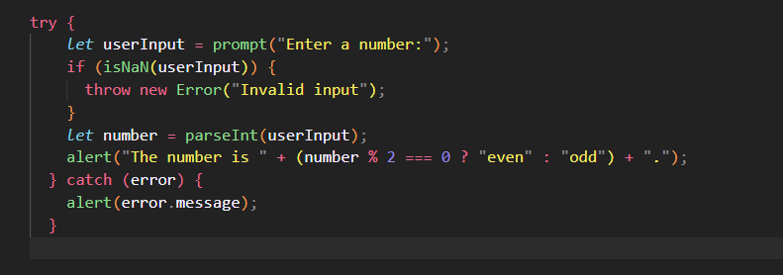
Basic Error Handling (try-catch)

Slide 8
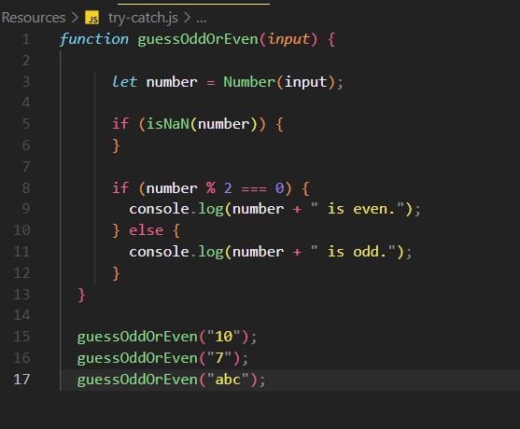
Apply try-catch

Slide 9
Practical Task: Mini Calculator
Concepts:
User input for two numbers.
Performing arithmetic operations.
Checking if results are odd or even.
Validating input.

